Slide 1
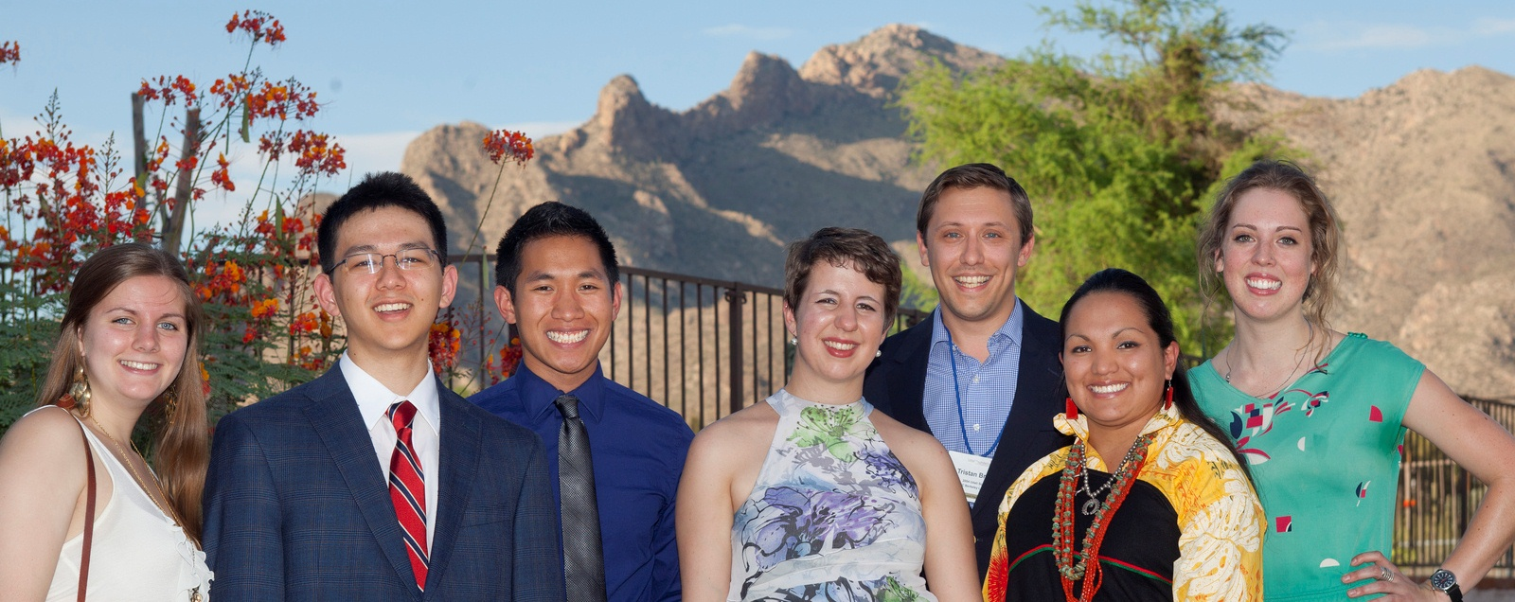
Udall Scholarship for Undergraduates
LeAnn Adam, Coordinator
National and Global Scholarships Advising, OSU
Udall Faculty Representative

Slide 2
Overview
The scholarship honors the legacies of Morris Udall and Stewart Udall whose careers had a significant impact on Native American self-governance, health, care, and the stewardship of public lands and natural resources.
udall.gov

Slide 3
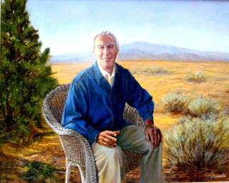
Stewart Udall
Secretary of the Interior from 1961 to 1969.
Under his leadership, the Interior Department aggressively promoted an expansion of federal public lands and assisted with the enactment of major environmental legislation.
udall.gov

Slide 4
Morris Udall
US Congressman from AZ from 1961 – 1991
“…His concern for Native Americans and the environment resulted in numerous pieces of legislation moving through congress.”
David Broder, Washington Post
udall.gov

Slide 5
Udall Scholarship Overview
Nationally Competitive Scholarship for college sophomores and juniors
Open to a range of majors
udall.gov

Slide 6
Overview
Strong candidates have demonstrated commitment to issues related to:
Environment
Undergraduates interested in conservation and environmental issues
OR: Tribal Policy
Native Americans and Alaska Natives working on an array of policy issues in Indian country
OR: Native Health Care
For Native Americans and Alaska Natives pursuing health-related careers
udall.gov

Slide 7
Overview
Candidates must demonstrate deep and sustained commitment to the environment through
leadership activities
public service (paid or unpaid)
community involvement
GPA is not a factor, but students should be engaged in challenging coursework that supports their career goals.
udall.gov

Slide 8
Overview
Each year, the Udall Foundation awards 55 scholarships of up to $7,000 each.
udall.gov

Slide 9
Who should apply?
Sophomores and juniors who are passionate about using their career to benefit the Environment
(just examples, not a complete list)
biology/ chemistry
enviro education
enviro economics
natural resources/ wildlife mgmt
engineering
journalism/ media
renewable energy
international relations
theater/ music/ visual arts
sustainable development
sustainable textiles and fashion
environmental justice
architecture and design
urban planning
sustainable agriculture
ecology
law and policy
marine science
waste management
…
udall.gov

Slide 10
Who should apply?
Sophomores and juniors who are passionate about using their career to benefit Indian country or their tribe in particular with an interest in Native American Tribal Policy or Health Care
traditional and modern arts
public health
Indian law
sovereignty and self-determination
gaming
criminal justice
child welfare
sustainable development
elder care
education
economic development
natural resources/ wildlife
language preservation
housing
journalism/ media
renewable energy
health care
social work
(just examples, not a complete list)
udall.gov

Slide 11
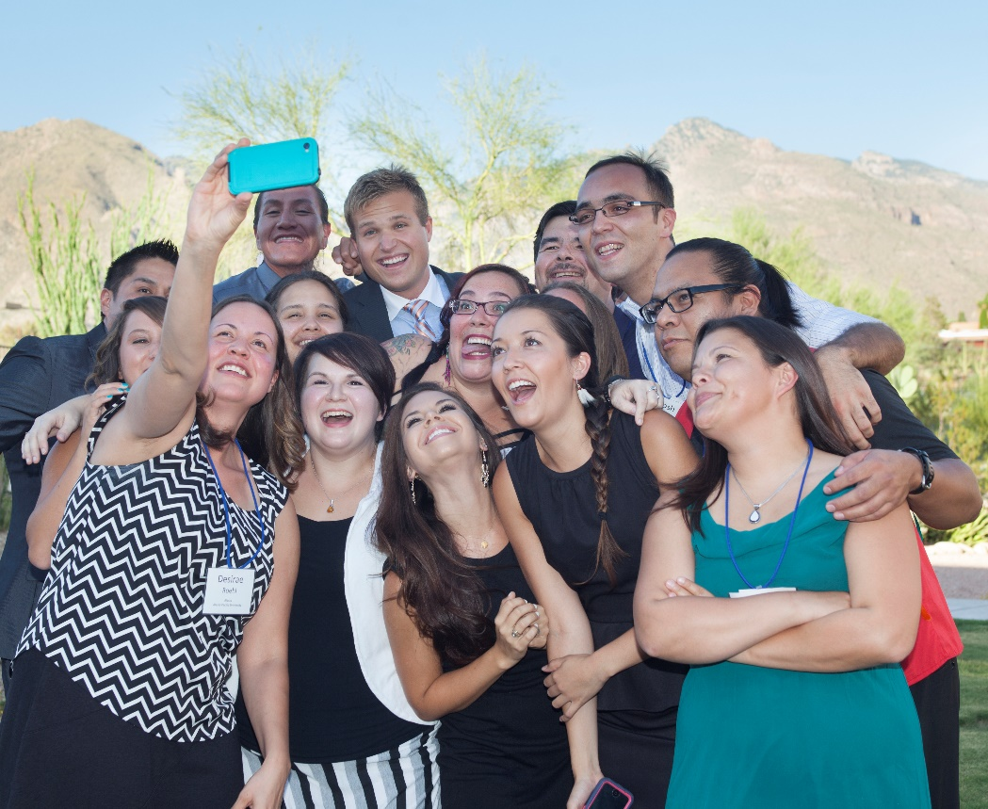
Why should I apply?
Join our growing alumni network of distinguished leaders.
Meet like-minded students working on important, diverse issues.
Multiply your impact by networking with other leaders and public servants.
$7,000 for study in the next academic year.
udall.gov

Slide 12
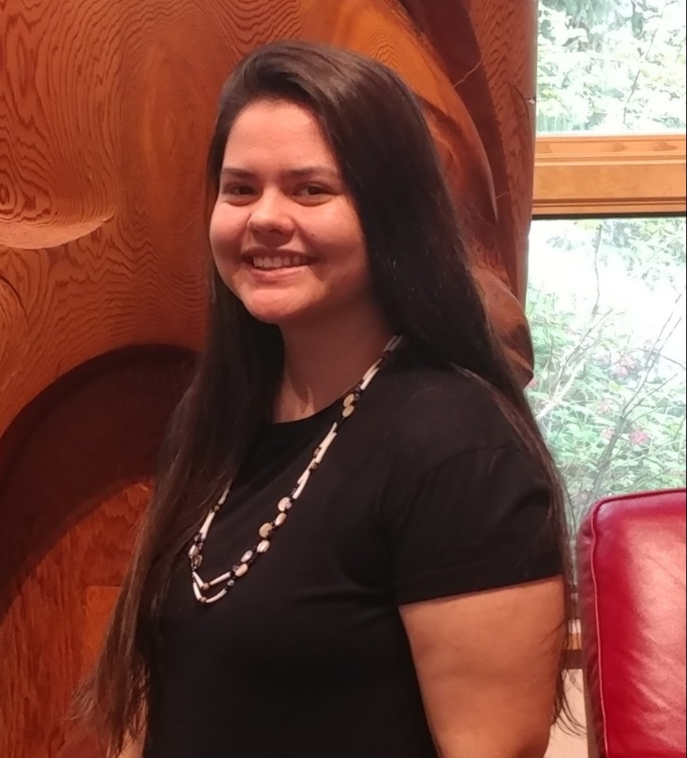
Qay-liwh Ammon, 2018 Scholar, Native Policy
Qay-liwh Ammon was awarded a Udall scholarship in the Tribal Public Policy category as a junior studying Environmental Science with an option is in Environmental Water Resources. She is from Salyer, CA and a member of the Hoopa Valley Tribe. In her career, Qay-liwh plans to return to Northern California to address low water flows, which has caused the fish population to decline, and work to improve current laws and policies.
udall.gov

Slide 13
udall.gov

Slide 14
Frequently Asked Questions
udall.gov

Slide 15
What is meant by Sophomores and Juniors?
Sophomores are in their second year of college (outside of high school).
The Foundation doesn’t worry about credits; terms of experience on campus are important.
Juniors have 1 more year to complete after the year in which they apply.
Selected Scholars must be enrolled full time all terms of the academic year after winning the award.
udall.gov

Slide 16
How do I demonstrate commitment to the environment?
Think of ways you’ve led positive solutions to environmental problems
“Crossing the aisle” is a big part of the Udall legacy
Consider how you’ve demonstrated “civility, integrity, and consensus” in your work
udall.gov

Slide 17
How do I demonstrate commitment to tribal policy and health care?
Have you demonstrated your commitment to Indian country through participation in cultural activities and service to your community?
Are you working towards a career that will enable you to impact health care for your tribe or for Native Americans and Alaska Natives?
udall.gov

Slide 18
How to Apply
Review Udall website
Make an appointment with your Udall Faculty Representative leann.adam@oregonstate.edu
Start the application early
Think about who will write your three references
udall.gov

Slide 19
How to Apply
Work with your Udall Faculty Representative
Online application
Short-answer questions (sample application available)
Essay (discuss a speech, legislative act, book, public policy statement by Morris or Stewart Udall and its impact on your field of study, interests and career goals)
Three letters of recommendation
Transcripts
Revise, Revise, Revise
udall.gov

Slide 20
Next steps and deadlines
Application opens: early September annually
Campus deadline: early February
OSU Campus committee meets to select four nominees in each category: mid February
Udall national deadline (LeAnn submits nominee materials): early March
Selection committee meets late March
Decisions announced by mid-April
Scholar Orientation in Tucson: August
udall.gov

Slide 21
OSU National and Global Scholarships Advising
LeAnn Joy Adam, Coordinator LeAnn.Adam@oregonstate.edu (541) 737-1996
Website:
http://topscholars.oregonstate.edu
Instagram:
https://www.instagram.com/scholarshipsadvising_osu/
udall.gov

