Slide 1
Notes:
Introduce yourself and your affiliation.
Find a way to connect with your audience: Either share a little of your background (what led you to your role) or go around the room and do brief introductions (name, year, FOS, country of interest, what are you passionate about?)
Big Picture: The Fulbright U.S. Student Program, provides 1-year, fully funded grants for graduating seniors, recent graduates, graduate students, and young professionals to conduct individually designed research projects, enroll in graduate school, or teach English abroad.

Slide 2
The Fulbright Program
Program Goal
History and Administration
Our mission is to foster mutual understanding between nations, advance knowledge across communities, and improve lives around the world
Created in 1946 by U.S. Congress
Sponsored by the U.S. Department of State’s Bureau of Educational and Cultural Affairs (ECA)
U.S. Student Program administered in the U.S. by IIE
Administered overseas by bi-national Commissions and U.S. Embassies
Notes:
Video Resource: What is Fulbright? https://www.youtube.com/watch?v=VlSENGOXGKg
For this slide, it is important to stress that the Fulbright program is an international exchange program.
Proposed in 1945 by Arkansas Senator J. William Fulbright and signed into law by President Truman on August 1, 1946, the Fulbright Program is the flagship international educational exchange program sponsored by the U.S. government.
The advancement of our mission of fostering mutual understanding between nations, advancing knowledge across communities, and improving lives around the world is the heart of Fulbright.
Fulbright is an opportunity to build lasting relationships, expand one's network and advance one's career
The Fulbright Program not only offers grants to U.S. students and scholars to go abroad, but also offers grants to foreign students and scholars to come to the United States. Since its inception in 1945, the program has grown from just 88 grantees in the first year to over 8,000 annually.

Slide 3
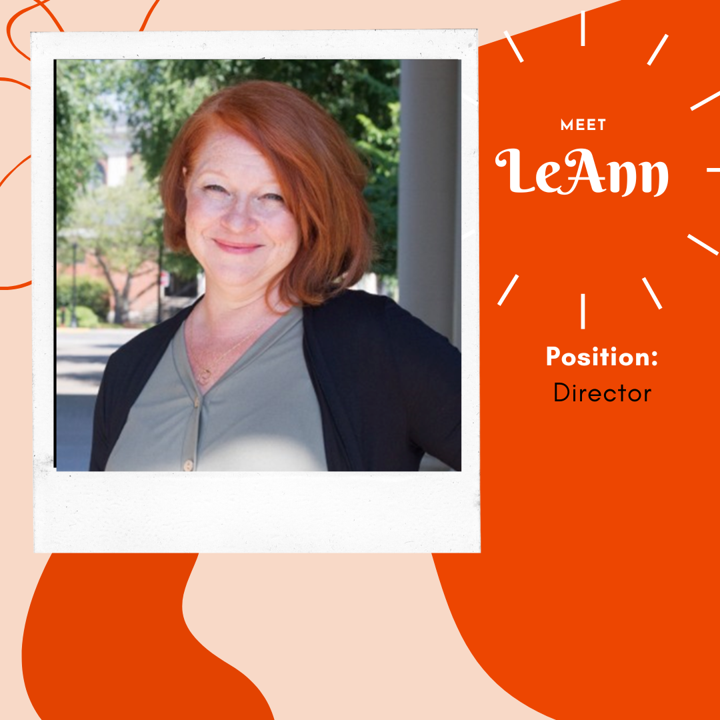
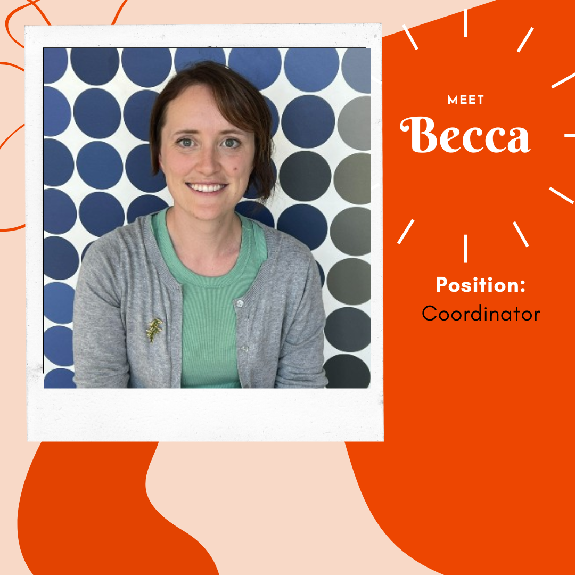
Who We Are:
OSU National and Global Scholarships Advising
We support undergraduate students, graduate students, and alumni throughout the process of applying to select, nationally-competitive scholarships and fellowships.
Notes:
"I Am Fulbright" Video Resource: https://www.youtube.com/watch?v=FcxVvd750dg
Diversity and Inclusion are cornerstone principles of the program
We are actively recruiting a diverse pool of applicants for the Fulbright program. Please encourage all people to consider Fulbright.
We've dedicated our time, energy and resources into finding talent.
We know that talent is everywhere and that's why I'm here today
We desire to have this program represent the diversity that makes up the U.S. and the U.S. Higher Education system

Slide 4
Diversity and Inclusion
Fulbright strives to ensure that it reflects the diversity of U.S. society and societies abroad. We encourage the involvement of people from traditionally underrepresented audiences in all our grants, programs and other initiatives.
Opportunities are open to people regardless of their race, color, national origin, sex, age, religion, geographic location, socioeconomic status, disability, sexual orientation or gender identity.
Notes:
"I Am Fulbright" Video Resource: https://www.youtube.com/watch?v=FcxVvd750dg
Diversity and Inclusion are cornerstone principles of the program
We are actively recruiting a diverse pool of applicants for the Fulbright program. Please encourage all people to consider Fulbright.
We've dedicated our time, energy and resources into finding talent.
We know that talent is everywhere and that's why I'm here today
We desire to have this program represent the diversity that makes up the U.S. and the U.S. Higher Education system

Slide 5
Fulbright U.S. Student Eligibility
Basic Eligibility
Graduating seniors
Recent graduates
Graduate students
Early career professionals, including creative and performing artists/musicians
U.S. citizen by the application deadline
Open to:
Bachelor’s degree or equivalent by start of grant
No doctorate at the time of application
Country-specific requirements
Notes:
The awards are open to all FOS, disciplines and areas of interest from the hard sciences to the creative and performing arts
Applicants to the Fulbright U.S. Student Program must be U.S. citizens at the time of application
Applicants must have a conferred bachelor's degree or the equivalent before the start of the grant.
Not have a PhD at the time of application
You do not have to be enrolled in an institute of higher education to be eligible
Have sufficient proficiency in the written and spoken language of the host country in order to communicate with the people and carry out the proposed project.
Fulbright is not one program, but 140 different programs because we are working with over 140 countries. Please consult the intended host country page on our website for country-specific detailed requirements.
During each competition cycle, candidates can only apply to one type of grant. Fulbright grants are traditionally for one country
Full Eligibility Requirements can be found online here: https://us.fulbrightonline.org/about/eligibility

Slide 6
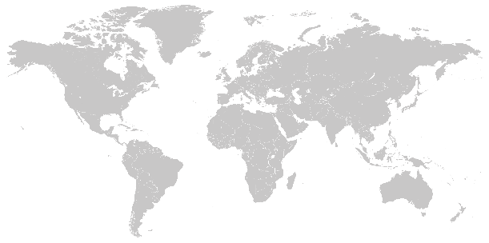
Program Award Types
Study/Research Grant
Independent research, study, or arts projects abroad
900+
6-12
~140
2,150+
Awards
Months
Countries
Awards
English Teaching Assistantship (ETA)
140+
Help teach English and U.S. culture in the classroom
Countries Worldwide
1,250+
8-10
~75
Awards
Months
Countries
Notes:
Award Type Overview: https://us.fulbrightonline.org/applicants/types-of-awards
Award Search: https://us.fulbrightonline.org/applicants/award-search

Slide 7
Study/Research Grant
Applicants for study/research awards design their own projects and will typically work with advisers or do graduate study at universities abroad. The study/research awards are available in 140 countries. Program requirements vary by country, so the applicants' first step is to familiarize themselves with the program summary for the host country.

Slide 8
English Teaching Assistantship
The English Teaching Assistant (ETA) Programs place Fulbrighters in classrooms abroad to provide assistance to the local English teachers. ETAs help teach English language while serving as cultural ambassadors for the U.S. The age and academic level of the students varies by country, ranging from kindergarten to university level.

Slide 9
Award Benefits
Round-trip airfare
Monthly stipend*
Accident and sickness benefits
Online TESOL Fundamentals Course (ETA only)
Other possible benefits*
• Support for dependents
• Research allowance
• Tuition
• Language lessons
• Enhancement activities
• Disability-related accommodations
Post-Grant
Fulbright network of alumni
State Department’s alumni website
Eligible for 12 months of noncompetitive eligibility hiring status within the federal government
Lifetime Fulbright email address
Fulbright Association

Slide 10
Application Components
Basic Personal Data & Program Information
Abstract, Host Country Engagement, Future Plans
2. Essays
Statement of Grant Purpose
Research/Study (2 pg max)
English Teaching Assistantship (1 pg max)
Personal Statement (1 pg max)
3. Reports / References
Foreign Language Evaluation
Three (3) References
4. Transcripts
5. Other
Research/Study: Affiliation Letter(s)
Arts: Supplementary Materials
Notes:
Within the Fulbright Application system, preliminary questions will impact the information that will be visible on subsequent pages of the application. As such, these must be answered correctly.
Short answer questions:
Essays: The heart of the application. This is where you should address the what, when, where, why, and how of your Fulbright project.
The Statement of Grant Purpose for S/R awards is a 2-page document detailing an intellectually-compelling and feasible project proposal or justification for pursuing a graduate degree program.
The Statement of Grant Purpose should make it clear why you must go to the host country in order to complete your proposed research or study program, and that you have the requisite academic or professional experience and language skills to fulfill your proposal.
The Statement of Grant Purpose for ETA awards is a 1-page document detailing why you are interested in teaching English to non-native speakers, as well as why you have chosen to apply to a particular country.
The Statement should describe any teaching or related experience, while clearly describing what you will bring to the classroom in the host country; including lesson plans, activity ideas, and educational strategies you plan to implement.
The Personal Statement is a 1-page biography in narrative form. It is an opportunity to introduce yourself to the screening committee members on a personal level.
The style is up to the writer, but the content should convey one's background and motivation for applying to the program and how this opportunity fits into one's future plans.
Full Application Components (and Tips): https://us.fulbrightonline.org/applicants/application-components
Application Check List: https://us.fulbrightonline.org/applicants/application-checklists

Slide 11
OSU’s Support for your Fulbright Application:
Brainstorm ideas and share referrals
Read and give feedback on essays
Canvas course
Interviews/committee feedback
Writing consultant
University endorsement of applications
Debrief and support through the selection/acceptance process
Celebration!

Slide 12
Fulbright Application Timeline
August 12, 2024 | OSU campus Fulbright deadline
September, 2024 | OSU campus interviews (via Zoom)
October 8, 2024 | Fulbright national deadline
November-December 2024 | Fulbright NSC meets
Late January, 2025 | Candidates are notified if they have been selected as semi-finalists
January-March, 2025 | Fulbright committees in the host countries meet to select Fulbright finalists
February-June, 2025 | Candidates are notified of final status
Design Project and Prepare Application
Campus Deadline (Interviews in September)
Host Country Review: Fulbright Commissions and/or U.S. Embassy
Final Selection and Notification: Fulbright Foreign Scholarship Board
Notes:
The application cycle opens annually at the end of March.
Applicants are encouraged to begin the process of selecting a grant and country and contacting their Fulbright Program Adviser and other possible advisers who will assist with application preparation. Applicants should begin designing their project and preparing their application as soon as possible after the application cycle begins.
National deadline is Tuesday, Oct. 11th, 2022 at 5pm ET. We will Not accept any applications after that date and time.
After the National Deadline in October, applications will be reviewed by the National Screening Committee (or NSC). The NSC meetings are comprised of U.S. college faculty and professionals representing various academic and artistic disciplines from institutions across the United States.
Applicants will be notified in the application system, as early as December, if they are selected as a Semi-Finalist and their application recommended to the host country for further review.
Fulbright Commissions and U.S. Embassies review semi-finalist applications and make selections. Country selections are then approved by the J. William Fulbright Foreign Scholarship Board.
In most cases, grant dates correspond to the academic calendar of the host country. Approximate dates of the academic year in each country can be found its Country Summary page on our website, us.fulbrightonline.org.
For more on Award Benefits: https://us.fulbrightonline.org/about/award-benefits

Slide 13
Stay connected with us.
Watch our webinars at us.fulbrightonline.org
Email us at Fbstudent@iie.org
Visit our website to learn more about the Fulbright U.S. Student Program
Watch videos at vimeo.com/fulbright and youtube.com/fulbrightprogram

Slide 14
Questions and Answers

Slide 15
OSU National and Global Scholarships Advising
Email:
leann.adam@oregonstate.edu
rebecca.otto@oregonstate.edu
Website:
topscholars.oregonstate.edu
Instagram:
@scholarshipsadvising_osu
Appointments:
beav.es/Ugj
Notes:
"I Am Fulbright" Video Resource: https://www.youtube.com/watch?v=FcxVvd750dg
Diversity and Inclusion are cornerstone principles of the program
We are actively recruiting a diverse pool of applicants for the Fulbright program. Please encourage all people to consider Fulbright.
We've dedicated our time, energy and resources into finding talent.
We know that talent is everywhere and that's why I'm here today
We desire to have this program represent the diversity that makes up the U.S. and the U.S. Higher Education system

